Slide 1

Scrum meeting 23/10/24
Scrum master: Daniel

Slide 2
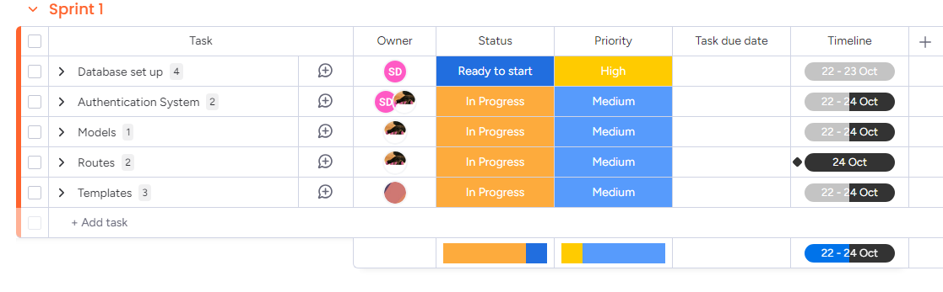
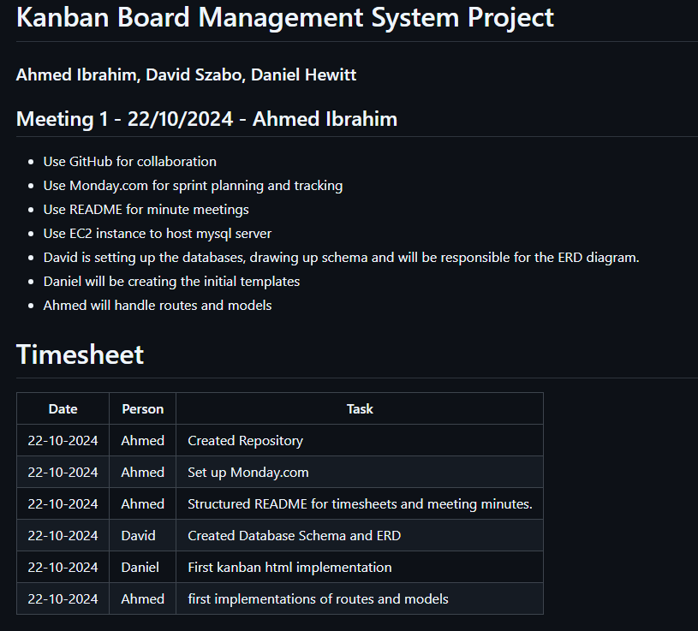
What was worked on
Used Monday for sprint planning and backlog

Slide 3

Plan for Today
Daniel: finishing HTML templates.
Ahmed: testing models and routes using local database
David: setting up sample data and setting up EC2

Slide 4
Product owner feedback
Sticky note style for kanban

